Slide 1
VCC Awareness Event
John McClelland
Contact Centre Practice Leader
March 25th, 2015

Slide 2
Rogers Slides
Add Slides Here

Slide 3

Our Team
Presented by: Marietta Davis
Nathaniel Adefowora
Trevor Helmus

Slide 4
Agenda Items
Introductions
What Makes Wisdom WFO Unique
Designed For Government
Implementation
Training
Forecasting
Scheduling
Agent Tools
Reporting / Dashboard
Cost Benefits

Slide 5
Who We Are
Canadian Company Based in Ottawa
US Sales Based in Texas
Incorporated in 2003
Operating in Canadian Government since 2010
Diverse Customer Base
Health Care
Government
Banking
Media

Slide 6
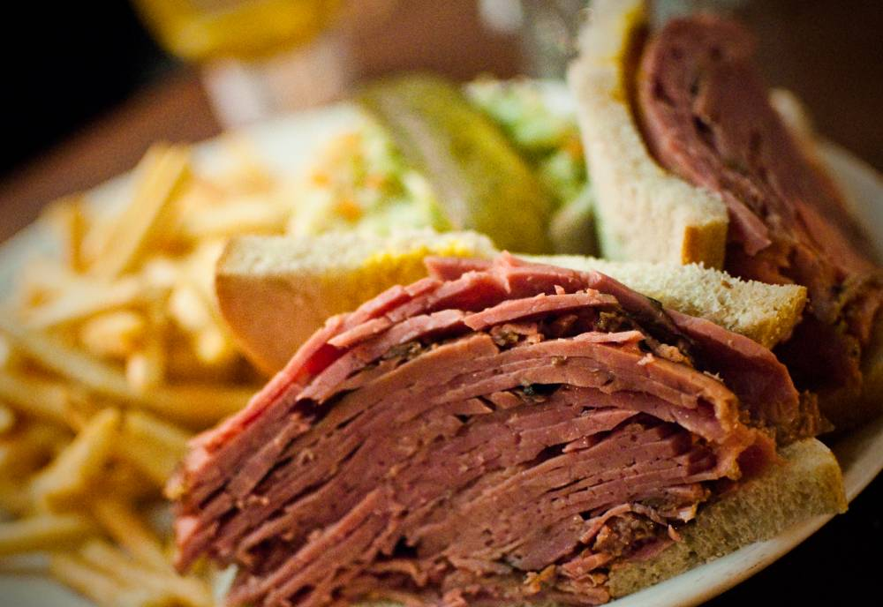

My Day in Montreal

Slide 7

My Day in Montreal

Slide 8
The Truth about Traffic…
Coordination is a bigger problem than the number of cars
When traffic backs up, it cascades into gridlock
Gridlock takes hours to clear
Traffic jams that we look at right now, may be the result of
something that happened hours before
Looking at a snapshot of the traffic jam doesn’t show the cause
With better coordination, more cars, flow faster through the same streets

Slide 9
Also True in Call Centers
Just one or two interval with not enough agents can cause long queues to cascade across the rest of the day
Once the queues get long, it can take hours to clear
If the Queues are long now, its often rooted in what happened much earlier in the day
Precise scheduling of agents helps calls to flow through swiftly
If calls are congested, then data snapshots do not help

Slide 10
What Makes Wisdom WFO Unique
Network Level Processing - Cross Interval Forecasting
Method | Wisdom WFO | Interval Based
Network Level Activity | Yes, Toll Free, IVR, ACD, VM, etc. | ACD Queue Only
Backlogs | Analyzes how to Clear Backlogs | No Information
Call Length | Exact length of every call | Averages only
Call Spikes | Detail Analysis | Averages only
Calls Lasting Across Intervals | Every Call Exactly | Assume all calls end
Data Analysis | Continuous (Second by Second) | 15 min. snap shot (2 values)

Slide 11
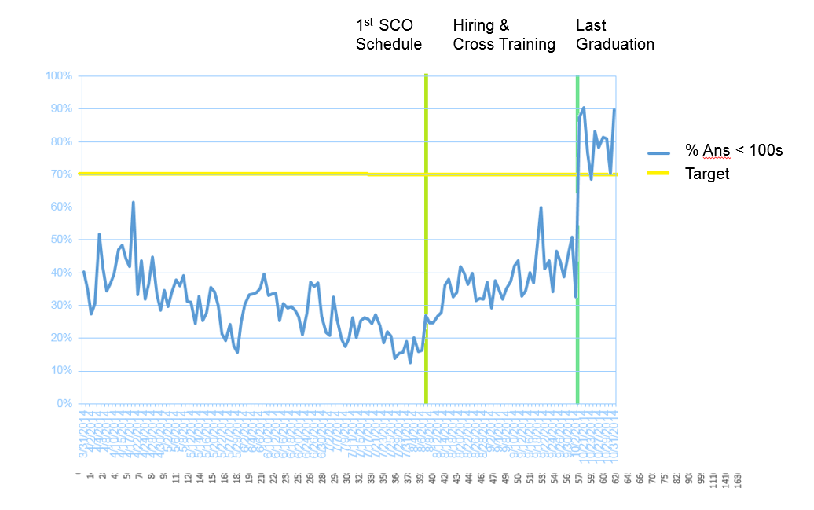
Coordination in Private Sector = Results
2 Months

Slide 12
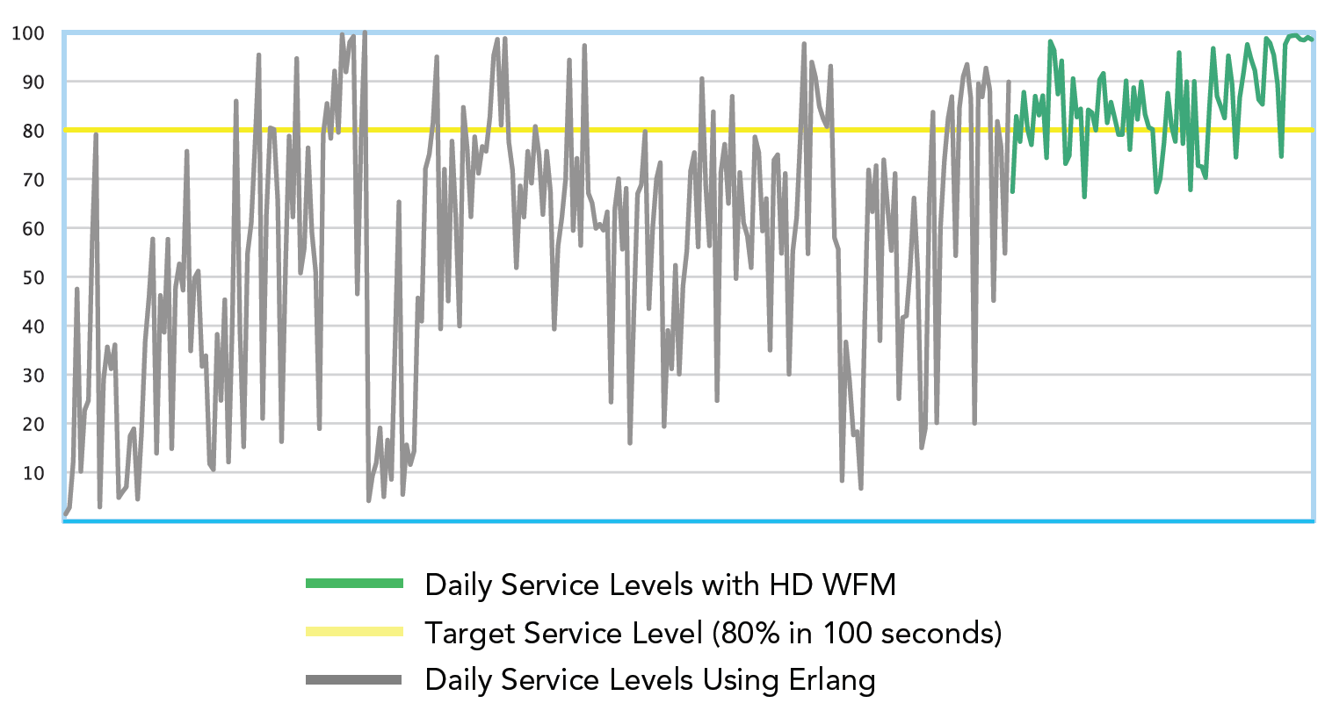
Coordination in Government = Results
Government Call Centre Improvements:
Better Coordination = Improved Service Levels
No Hiring Required
Daily Service levels before After

Slide 13
Coordination in Government = Results
Government Call Centre Improvements:
Labor Productivity
Attendance
Complaints
Agent Moral
First Call Resolution
Preparedness
Management/Union Relations
Wait time Consistency

Slide 14
Turning Data Into a Forecast
Collect Historical Data / Call Center Details
Create Basis Days / Automatic Basis Days
Choose Appropriate Service Level
Choose Risk Preparedness

Slide 15
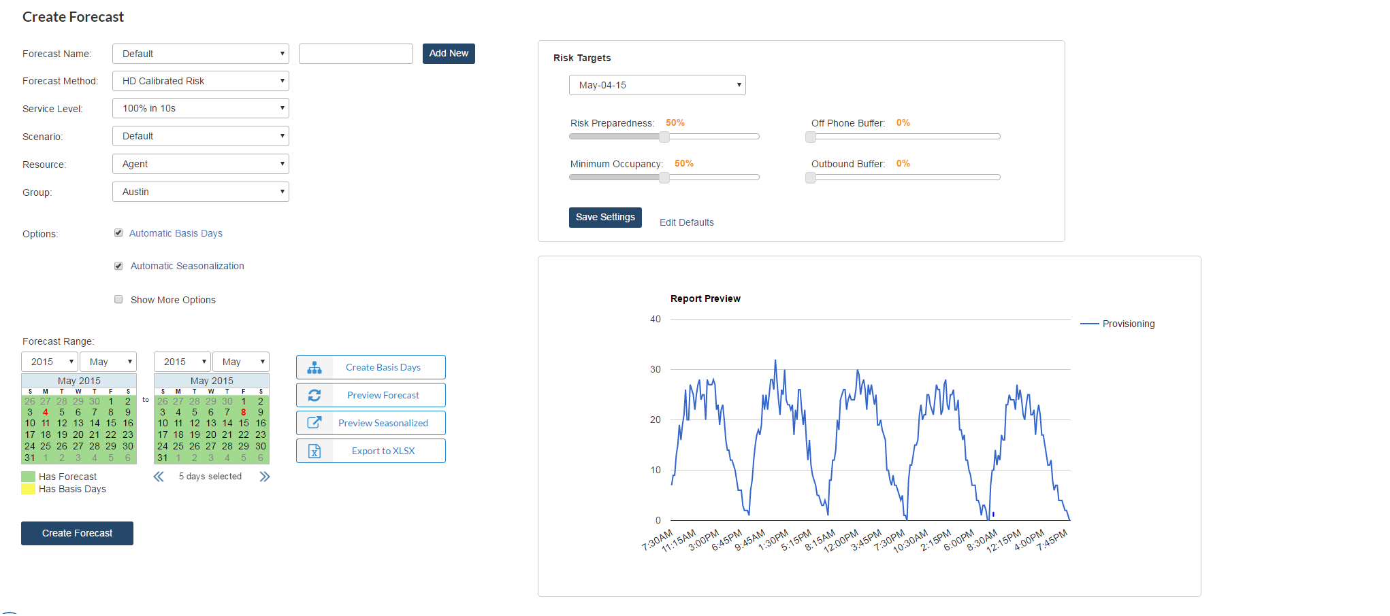
Turning Data Into a Forecast

Slide 16
Scheduling across Channels
Intricate coordination across phones, paper, email. Across Queues. Across Organizations
Phone/Off Phone synchronization:
Phone forecast satisfied first
Off phone work assigned to each agent to fill the buffer
Automatic Cross Service Coordination:
Pockets of staffing shortages in one group, are filled using surpluses from a linked group
The helper agents see work segments on their schedule telling them when to switch queues.
Coordination of distinct Call Centers in a common campaign.

Slide 17
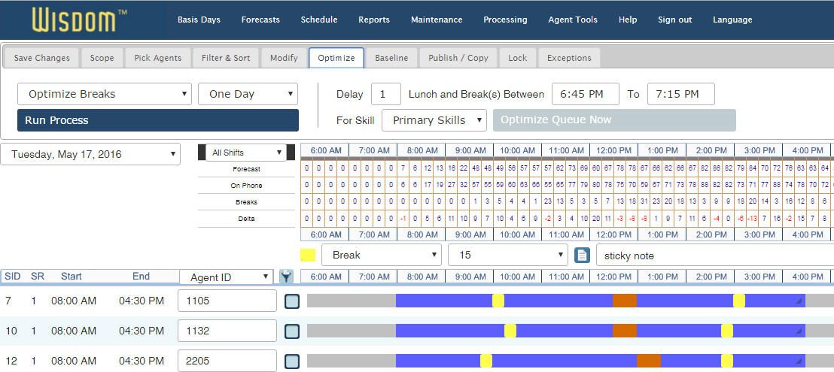
Designed for Government
Real Information Makes Everything Easy

Slide 18
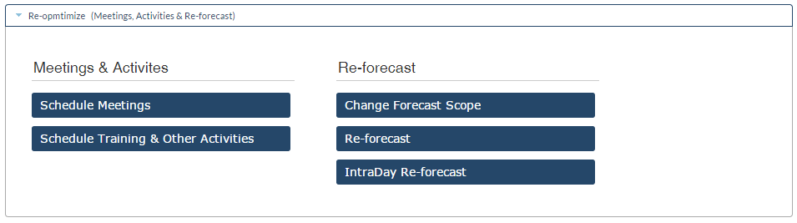
Designed for Government
Real Information Makes Everything Easy

Slide 19
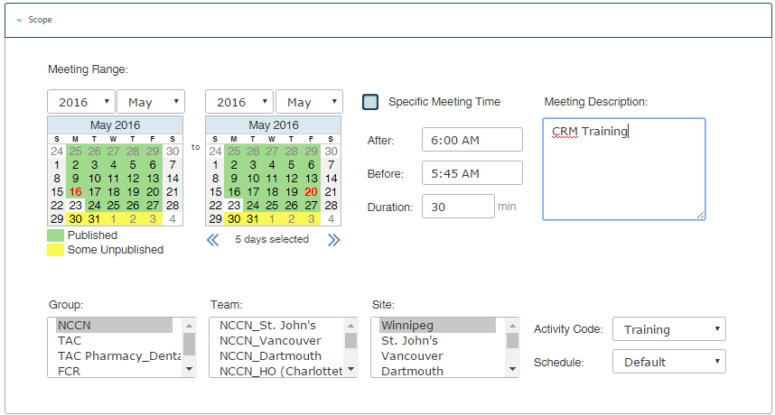
Designed for Government
Plan meetings, events and training

Slide 20
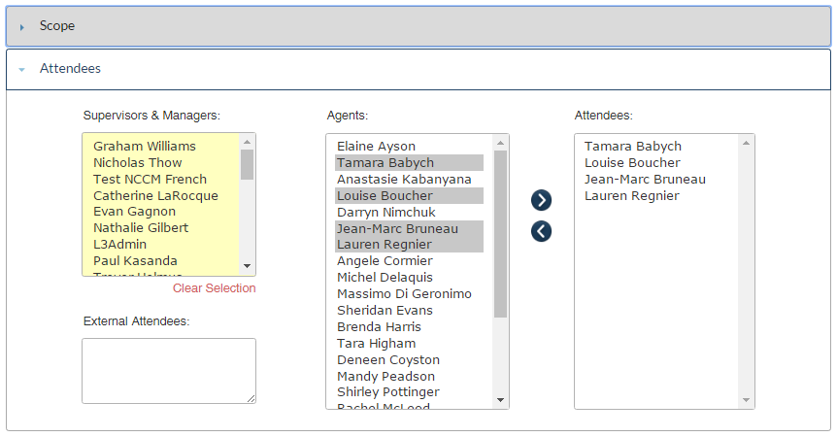
Designed for Government
Real Information Makes Everything Easy

Slide 21
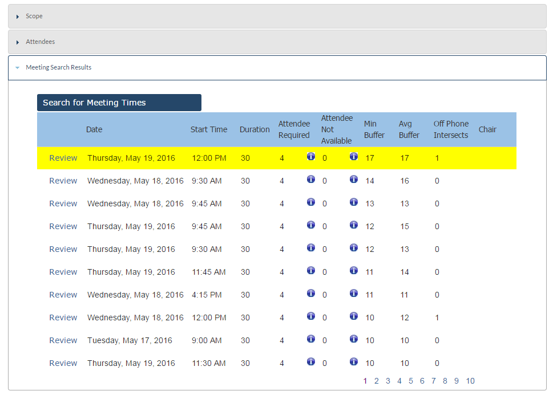
Designed for Government
Real Information Makes Everything Easy

Slide 22
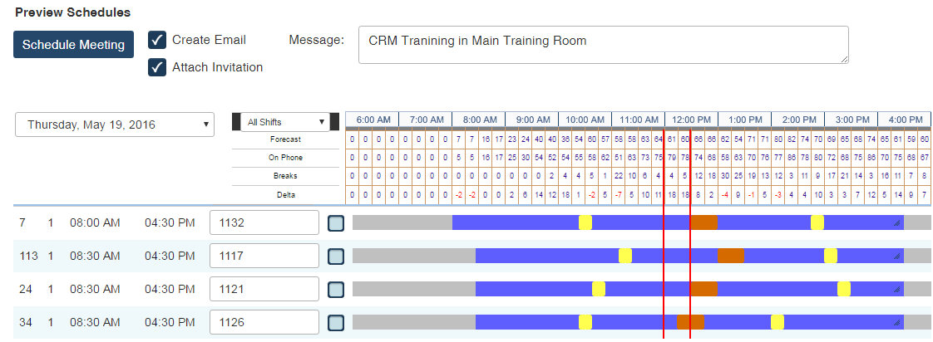
Designed for Government
Real Information Makes Everything Easy

Slide 23
Designed for Government
Dashboard
Customizable for agents / supervisors
Quick overview of daily schedule
Links to most visited pages
Quick and customizable reporting

Slide 24
Designed for Government
Reporting - Dashboard
Corporate, Real-Time, Custom reports
All aspects customizable
Tabs tailors to permission levels
Data directly linked to report server

Slide 25
Designed for Government
Reporting
Easy to use, flexible
Over 100 available reports
Pivot data available to customize reports
Real time excel reports available2

Slide 26
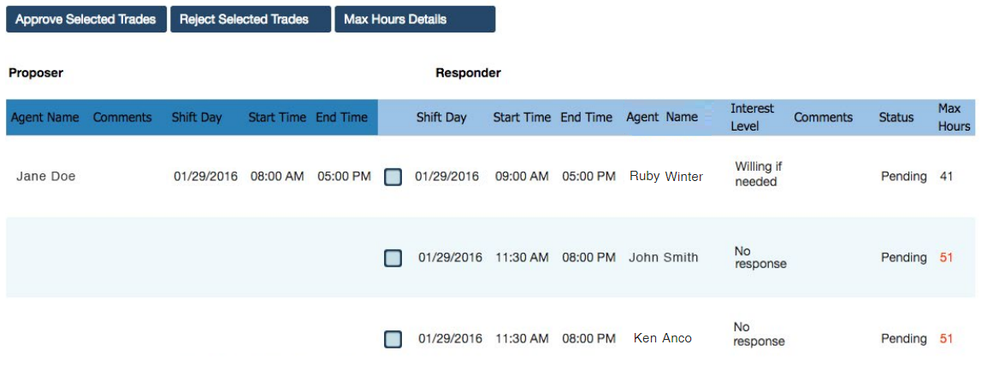
Designed for Government
Easy for Agents

Slide 27
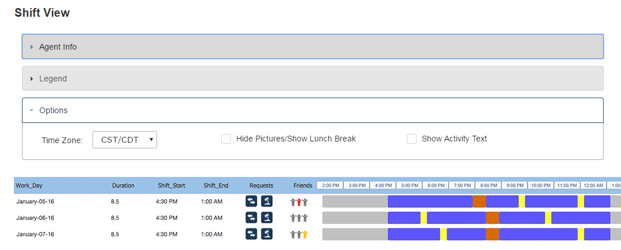
Designed for Government
Easy for Agents
Agents see who they are co-scheduled with

Slide 28
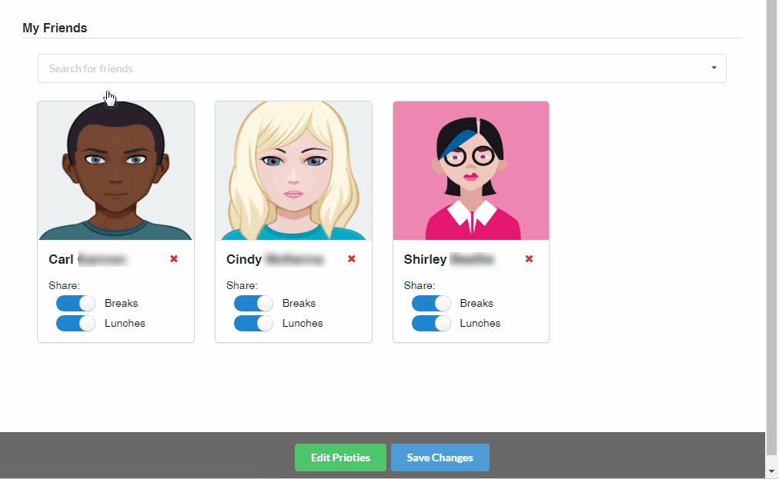
Designed for Government
Easy for Agents
Agents can select the friends they like to share breaks with

Slide 29
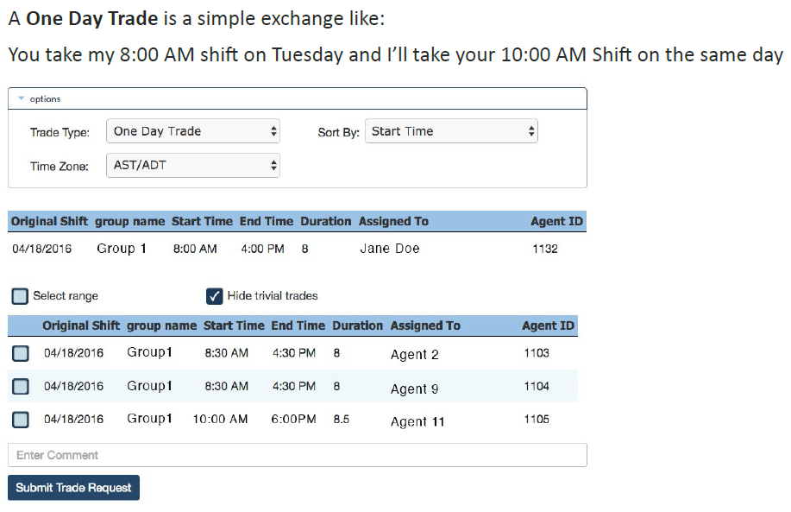
Designed for Government
Easy for Agents

Slide 30
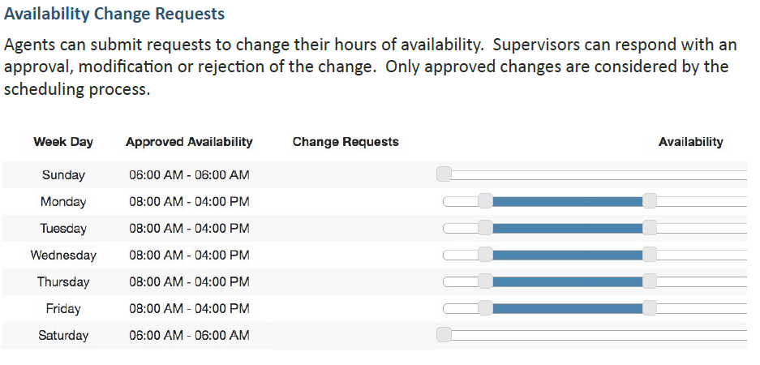
Designed for Government
Easy for Agents

Slide 31

Designed for Government
Easy for Agents
Intelligent Adherence
Fair
100% Adherence is achievable for diligent agents
Agents are not penalized arbitrarily
Agents may break early/late without penalty
Agents like it and believe in it
Frees supervisor time
Agents are free to fully service each caller

Slide 32
Designed for Government
Government Call Center Experienced Strong ROI Results
10.3 x ROI annually (1000% IRR)
Surpassed the break even point in less than 1 week
9.1% increase in Total Talk Time Productivity
10% reduction in repeat callers conversations
Net productivity gain between 10% and 20%
$1.50M annual productivity savings
Calculation: $50K agent Salary * 10% * 300 FTE
$360K savings from centralized scheduling
1 forecaster/scheduler now does the work of 7
$1.86M total annual savings
Operating cost of $15,000 per month ($180K/year)
$5000 Daily Savings

Slide 33
Designed for Government
Rapid, Broadly Based and Sustained Improvements
Labour Optimization Results:
10% CC Labor Reduction Y1, Same in Y2
25% reduction in cloud licensing requirements
SL improvement between 2x and 70x
Results equivalent to 25% hiring with no hiring
Infrastructure Optimization Results:
63% reduction in queuing costs
25% reduction in overall port requirements
25% reduction in overall toll free minutes
Happy Callers, Happy Agents, Happy Executives.

